Slide 1
Chapter 10

Slide 2
Objectives

Slide 3
Objectives (cont.)

Slide 4
The URL for the Bootstrap CSS classes documentation

Slide 5
Common CSS classes for working with buttons

Slide 6
Anchor and button HTML elements and server controls styled as buttons

Slide 7
Button server controls styled at various sizes

Slide 8
Common CSS classes for working with check boxes and radio buttons

Slide 9
CheckBox controls with default styling and a “not allowed” cursor

Slide 10
RadioButton controls styled to display inline

Slide 11
A CheckBoxList control with default styling

Slide 12
Common CSS classes for working with images

Slide 13
Img elements styled with various shapes

Slide 14
Common CSS classes for working with ordered and unordered lists

Slide 15
An unordered list element with default styling removed

Slide 16
A BulletedList control styled to display inline

Slide 17
Common CSS classes for working with HTML tables

Slide 18
A table with default styling

Slide 19
A condensed table with a border and alternating stripes

Slide 20
Common CSS classes for text

Slide 21
Some examples of the text CSS classes

Slide 22
The four main contextual classes available to most elements

Slide 23
Four more contextual classes

Slide 24
Buttons with contextual classes

Slide 25
Text with contextual classes

Slide 26
A table cell with a contextual class

Slide 27
The URL for the Bootstrap components documentation

Slide 28
LinkButton controls with glyphicons

Slide 29
Hyperlink controls with glyphicons

Slide 30
A LinkButton control with a badge

Slide 31
Common CSS classes for creating button groups

Slide 32
A basic button group

Slide 33
A group of justified buttons

Slide 34
A toolbar with two button groups

Slide 35
CSS classes for creating button dropdowns

Slide 36
A button dropdown

Slide 37
A split button dropdown

Slide 38
Common CSS classes for creating list groups

Slide 39
A basic list group

Slide 40
A list group of links with badges

Slide 41
Common CSS classes for creating alerts

Slide 42
A dismissible alert with a link

Slide 43
Common CSS classes for creating breadcrumbs

Slide 44
A breadcrumb with four segments

Slide 45
Common CSS classes for creating thumbnails

Slide 46
Three basic thumbnails

Slide 47
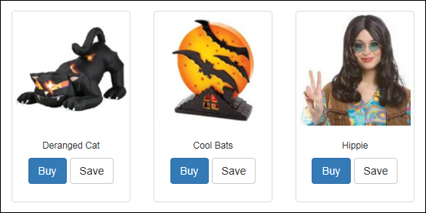
Three thumbnails with captions

Slide 48
The aspx code for the thumbnails

Slide 49
Common CSS classes for creating navs

Slide 50
An unordered list styled as tabs

Slide 51
An unordered list styled as justified tabs

Slide 52
A BulletedList server control styled as pills

Slide 53
Common CSS classes for creating navbars

Slide 54
A default navbar at desktop width

Slide 55
The aspx code for the navbar

Slide 56
The aspx code for the navbar (cont.)

Slide 57
More CSS classes for creating navbars

Slide 58
A static navbar at the top of the screen

Slide 59
A navbar that’s fixed at the bottom of the screen

Slide 60
An inverse navbar that’s fixed at the bottom of the screen

Slide 61
The URL for the bootstrap-theme style sheet documentation

Slide 62
The CSS files that are downloaded with the Bootstrap NuGet package

Slide 63
How to add the bootstrap-theme style sheet to a web page

Slide 64
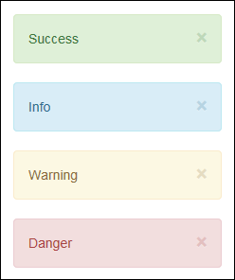
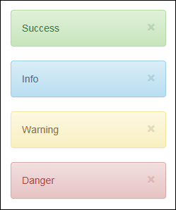
Styling applied to alerts with the main and bootstrap-theme style sheets

Slide 65
The URL of the Bootswatch website

Slide 66
How to set the value that’s displayed in a badge

Slide 67
How to mark the current page in a navbar on a master page as active

Slide 68
How to mark the current page in a navbar on a master page as active (cont.)

Slide 69
How to mark the current page in a navbar on a master page as active (cont.)

Slide 70
How to use a Literal control to display breadcrumbs

Slide 71
How to use a Literal control to display breadcrumbs (cont.)

Slide 72
How to use a Repeater control to display a series of thumbnails

Slide 73
How to use a Repeater control to display a series of thumbnails (cont.)

Slide 74
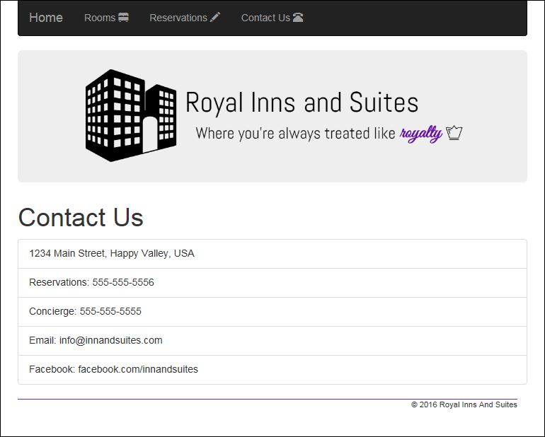
Extra 10-1 Use Bootstrap to enhance the Reservation application

